Slide 1
1

Slide 2
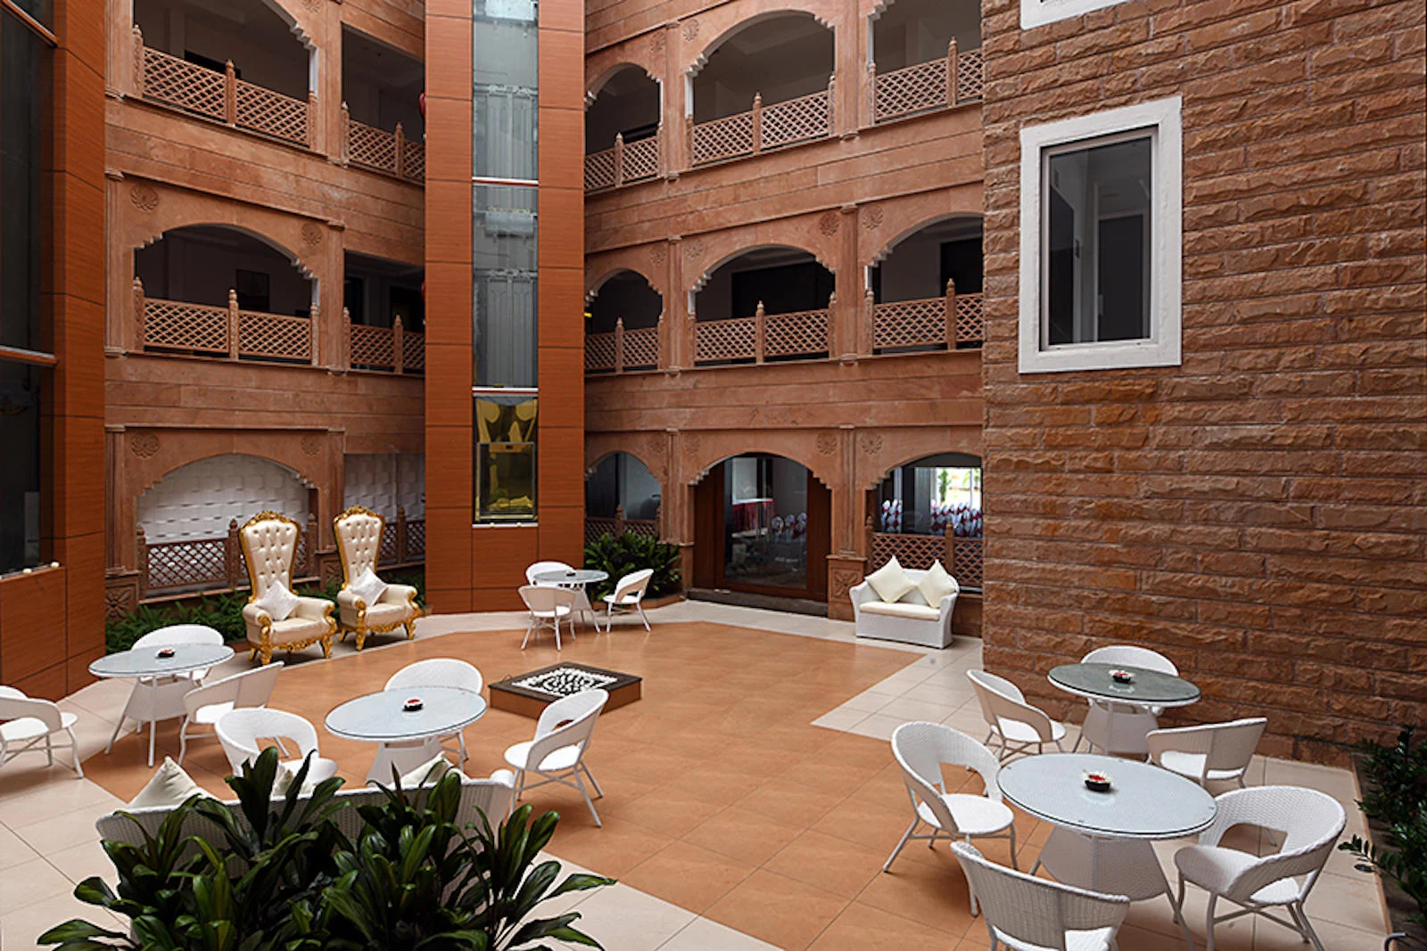

Slide 8
2

Slide 9
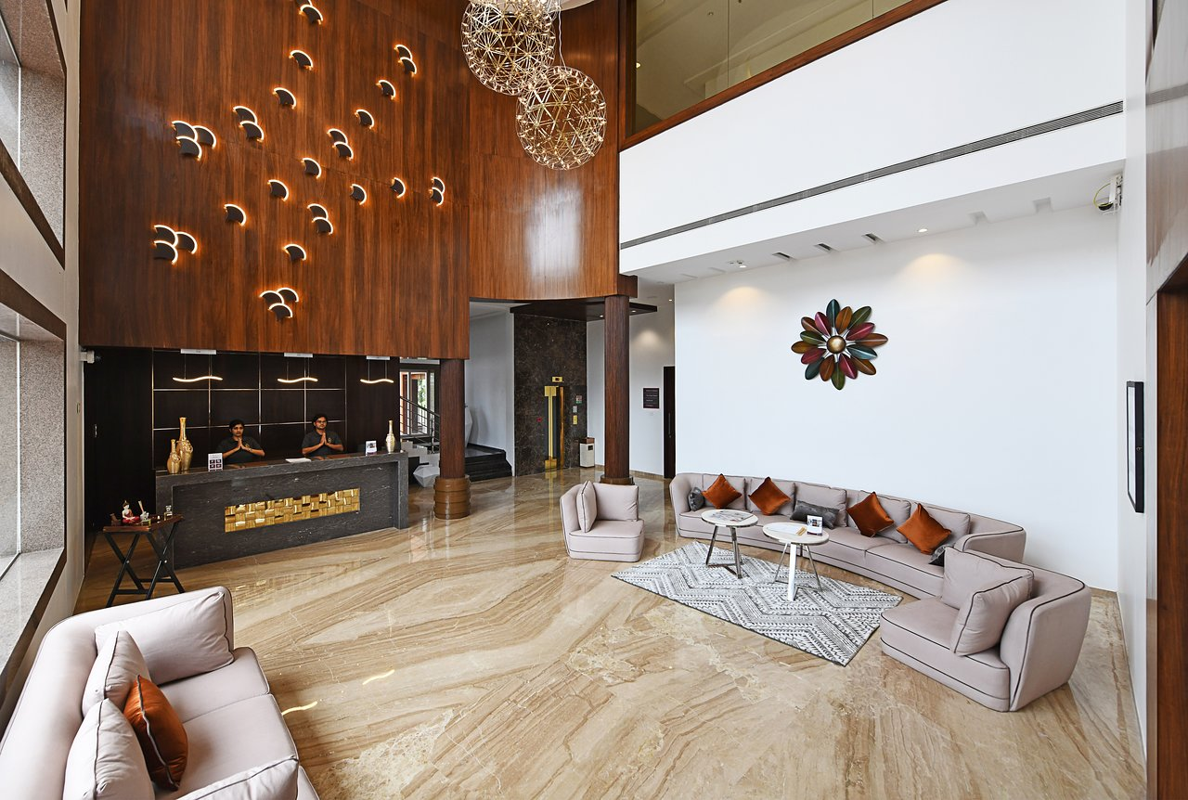

Slide 18
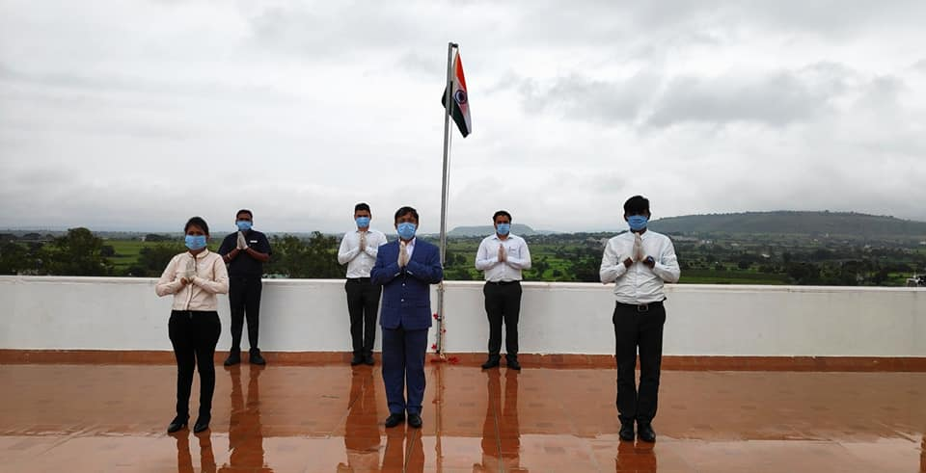

Slide 20
Akshay Sawant
IT Supervisor

Slide 21
Sunil Waghmare
Engg Supervisor

Slide 23





In 2008
Got 1 idea
2016 we find
1 that doing
great
2022 graph
as go to
upward
Growth from starting point
Working Hard
to Go
1996
2008
2016
2022
1978

Slide 24
Working Hard
to Go
1996
2008
2016
2022
1978

Slide 25
In 2008
Got 1 idea
1996
2008
2016
2022
1978

Slide 26
2016 we find
1 that doing
great
1996
2008
2016
2022
1978

Slide 27
2022 graph
as go to
upward
1996
2008
2016
2022
1978

Slide 28
Growth from starting point
1996
2008
2016
2022
1978

Slide 29
In 2008
Got 1 idea
2016 we find
1 that doing
great
2022 graph
as go to
upward
Growth from starting point
Working Hard
to Go
1996
2008
2016
2022
1978

Slide 32





